Slide 1

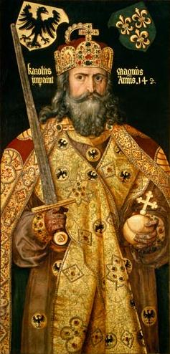
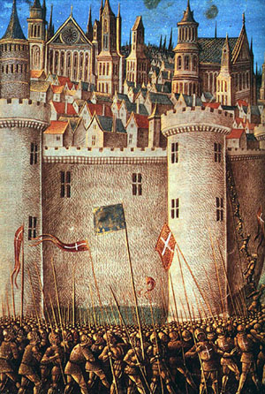
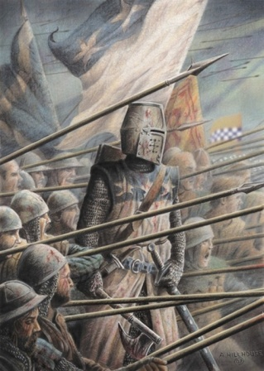
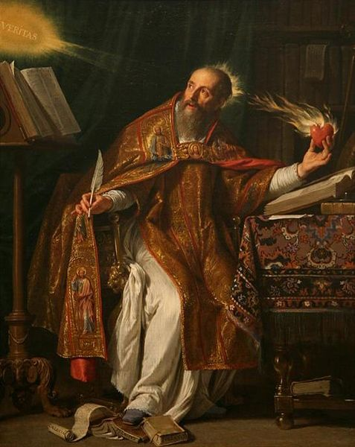
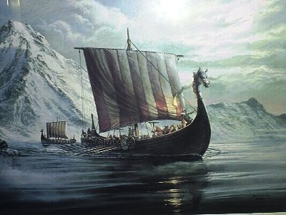
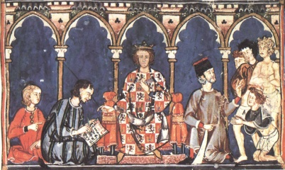
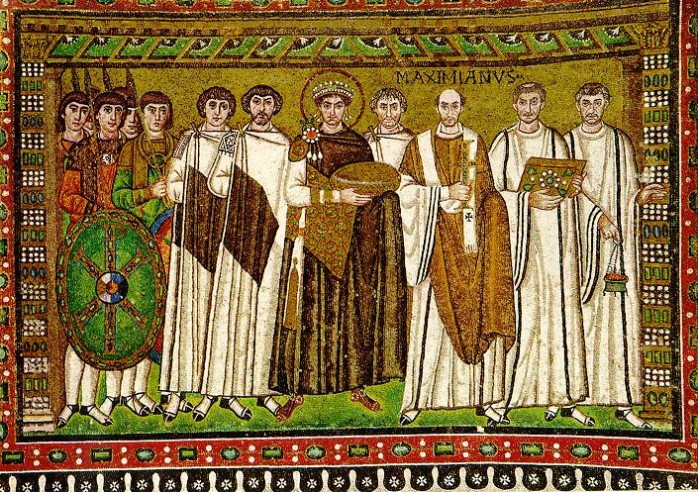
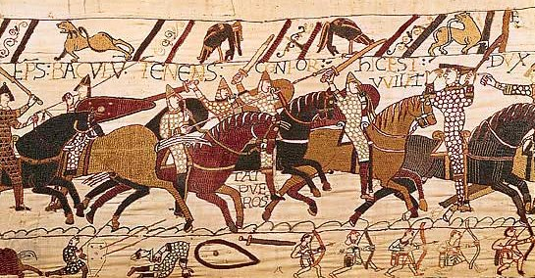
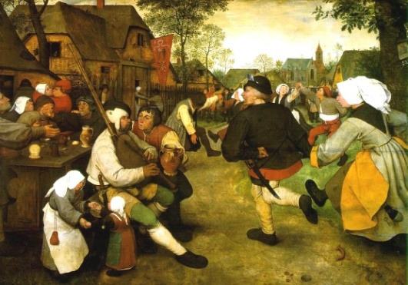
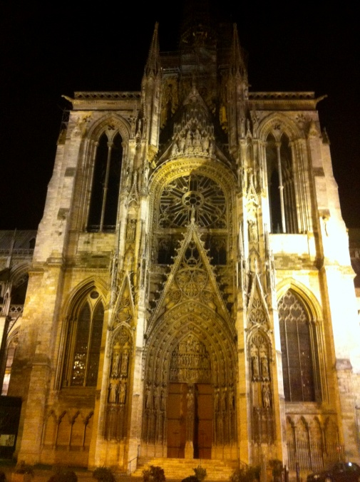
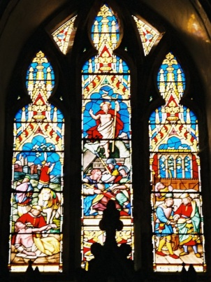
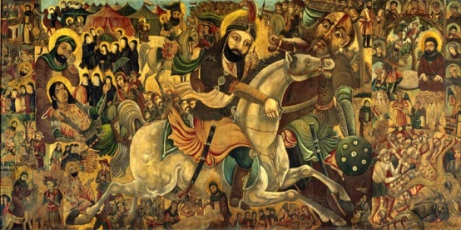
The Middle Ages

Slide 2
The Middle Ages
A period of time approx. from the fall of Rome to the beginning of the Renaissance - ~476 – 1500 C.E.
Medieval – Latin medium aevum means the middle age
Roughly divided into three eras:
Early Middle Ages (Dark Ages) 476 – c. 1000 C.E.
High Middle Ages c. 1000 – c. 1300 C.E.
Late Middle Ages c. 1300 – c. 1500 C.E.
The events and characteristics defined each era more than actual dates:
The High Middle Ages in France could be said to have begun during the reign of Charlemagne 768-814 C.E. while in England it did not begin until 1066 C.E. with the Norman invasion

Slide 3
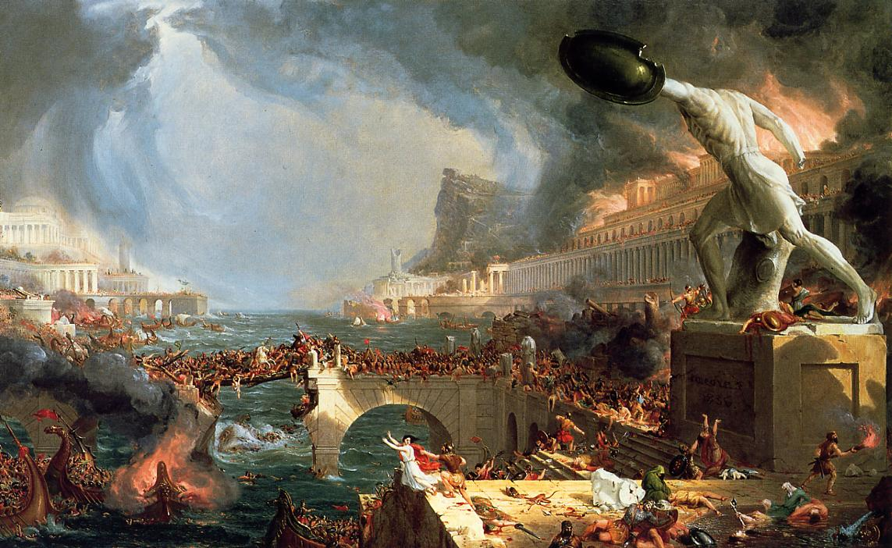
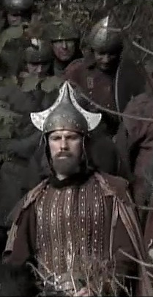
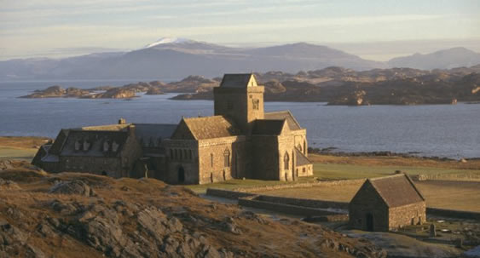
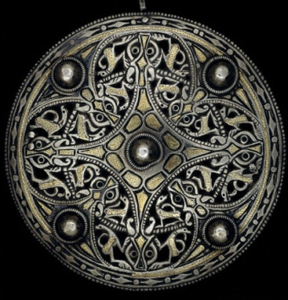
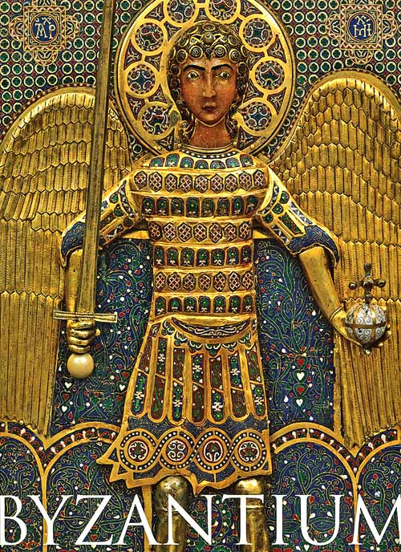
The Early Middle Ages
Characteristics
Fall of Rome (only power left is the church)
Germanic tribes fight each other for control of Europe
Cities shrink or are abandoned, and villages remain small and isolated – result of lack of trade
Monasteries are centers of education in Western Europe
Large areas of Europe (particularly in the north) are non-Christian (i.e. Pagan)
The Byzantine Empire remains powerful in the East

Slide 4
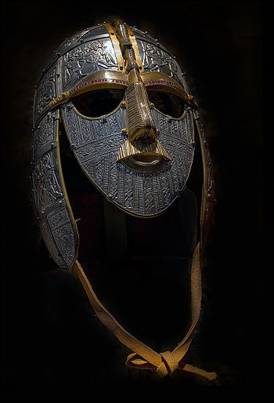
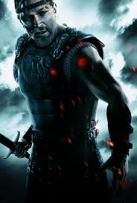
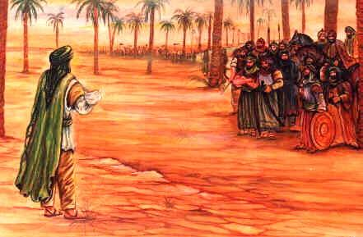
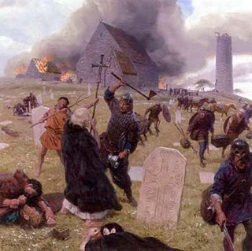
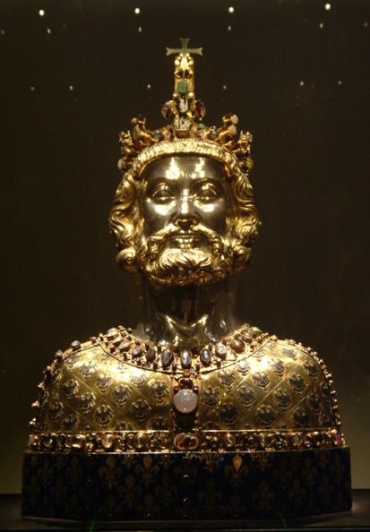
The Early Middle Ages
People and Events
Legends of King Arthur, Beowulf, and Roland set during this era
Anglo-Saxon culture dominates England
New religion of Islam rises and spreads rapidly across the Middle East, North Africa, and into Spain
Carolingians rise and fall in Western Europe (greatest leader Charlemagne)
Viking Raids terrorize Europe

Slide 5
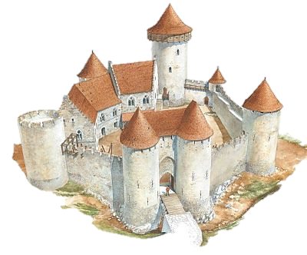
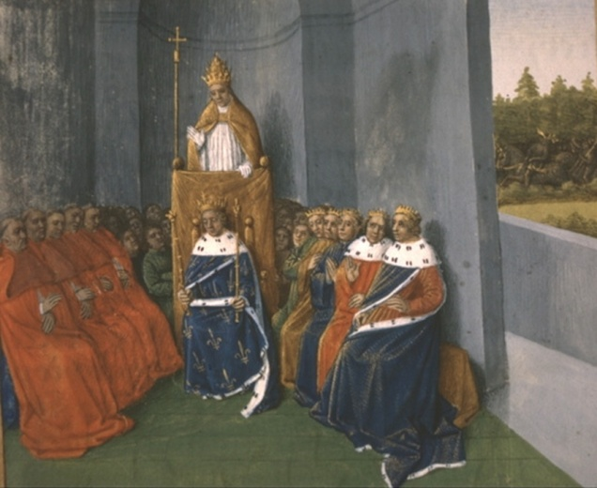
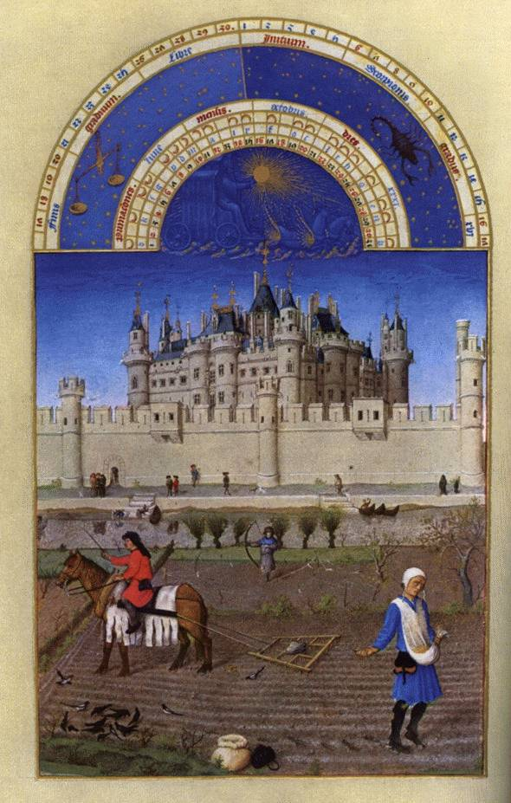
The High Middle Ages
Characteristics
Europe almost entirely Christian – Church at its most powerful
Period of stability brought about by the Peace of God and the Truce of God
Castles begin to dominate the land
Feudalism becomes common across Europe as peasants look to local Lords for protection
Kings are only as powerful as the Lords/Knights who support them

Slide 6
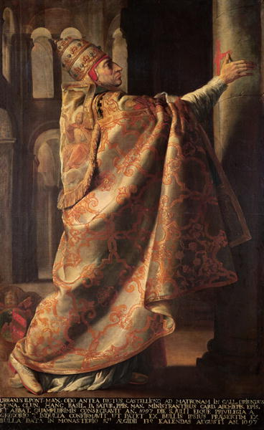
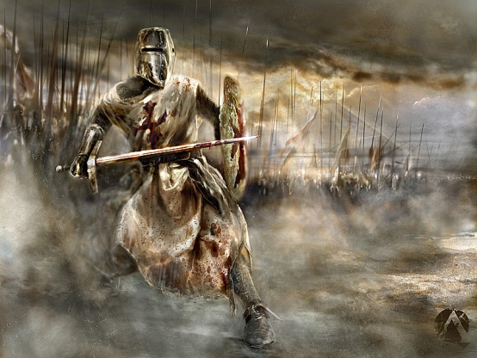
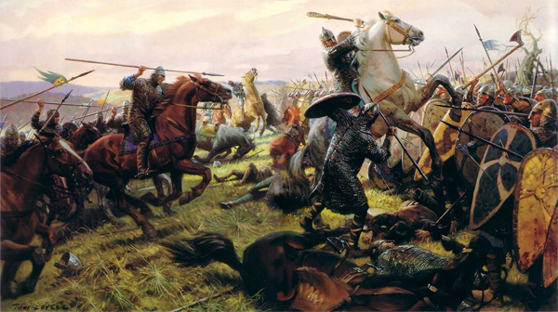
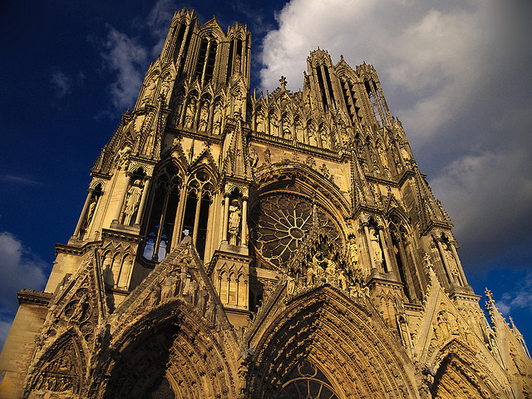
The High Middle Ages
People and Events
William of Normandy conquers England
The Byzantine Empire, greatly reduced in power, comes under threat from the Turks
Pope Urban II calls for a crusade to liberate the Holy Land – age of crusades begins
Gothic cathedrals appear across Northern Europe
Legend of Robin Hood set during this era
King John signs the Magna Carta in England

Slide 7
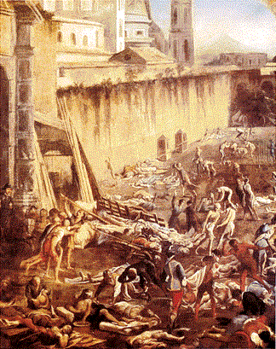
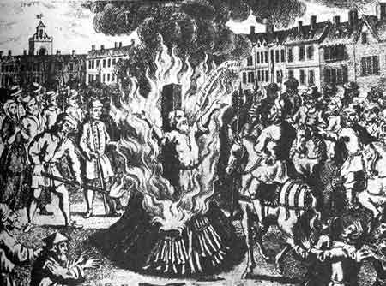
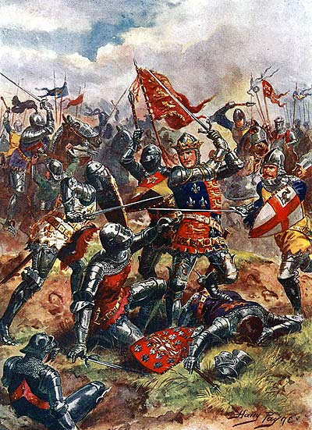



The Late Middle Ages
Characteristics
Period of great societal upheaval
Church begins persecuting anyone who holds heretical beliefs – many burned at the stake
Gunpowder first appears in European warfare
The Black Death sweeps across Europe killing anywhere from a third to half of the population
Kings become more powerful and challenge the power of the Church
Growth of Nations begins in Western Europe

Slide 8
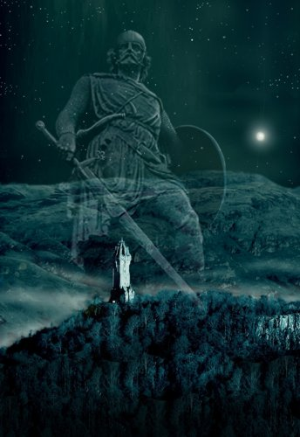
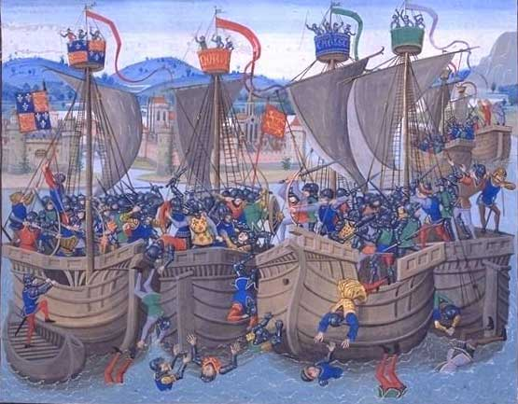
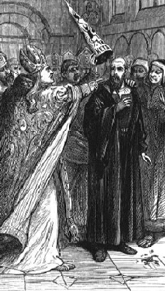
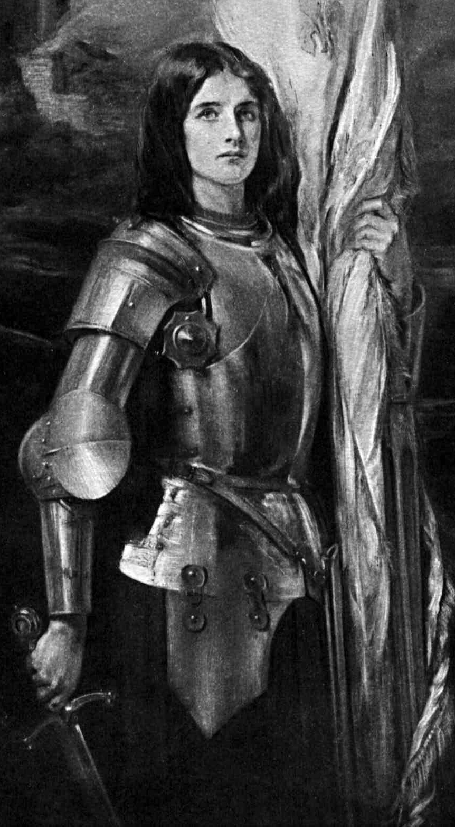
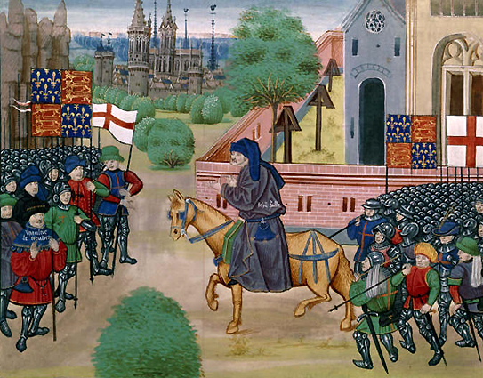
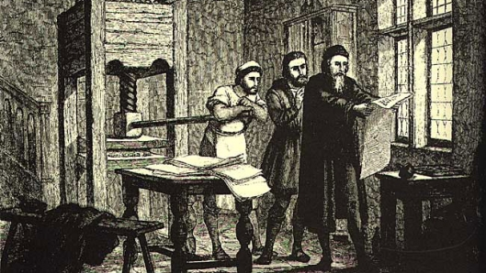
The Late Middle Ages
Mac’s History
People and Events
Edward I invades Scotland, resisted by William Wallace
Hundred Years’ War begins between the kings of England and France
Great Schism in the Catholic church weakening its power
Peasants revolt in England
Joan of Arc leads French forces to victory over English
Johannes Gutenberg invents the printing press

